Slide 1
RL Penalty Shooting
Group A34_14h_M
João Alves up202007614@up.pt
Marco André up202004891@up.pt
Rúben Monteiro up202006478@up.pt
RI @ FEUP | 2024/25

Slide 2
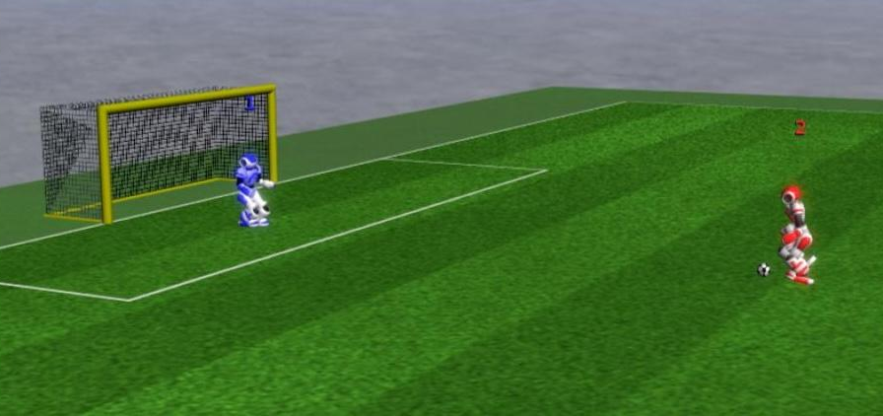
Project Description
Penalty Shooting Scenario using RL in RoboCup 3D Simulation
Train an attacker player agent to do penalty kicks with RL
Develop a basic heuristic-based goalie to defend the kicks

Slide 3
Objectives
Success is measured by meeting the following goals:
Goalie behavior is relatively solid at defending basic shots
Achieve a high percentage of successful goals with attacker agent via RL
Attacker can use different ball trajectories by taking into account the defender’s position

Slide 4
Used Software
RoboCup3D (simulator)
Roboviz (visualization)
FC Portugal (codebase and documentation)
Python (programming language)
OpenAI Gym (reinforcement learning)

Slide 5
Developed Work

Slide 6
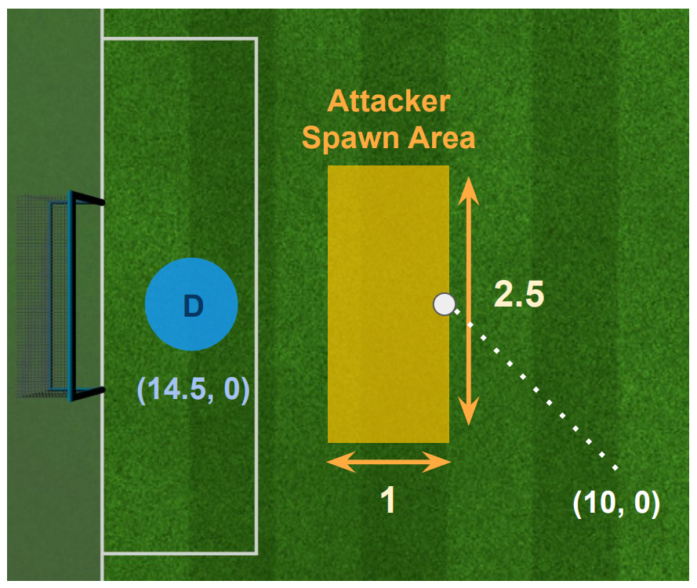
Start Position
The goalie, D, always spawns in the same position: at the center of the goal.
The attacker can randomly spawn in a predefined area near the goal, leading to:
More robust agent behavior to starting position and pose
Makes the training more challenging as the agents need to take relative positions, distances and angles into account

Slide 7
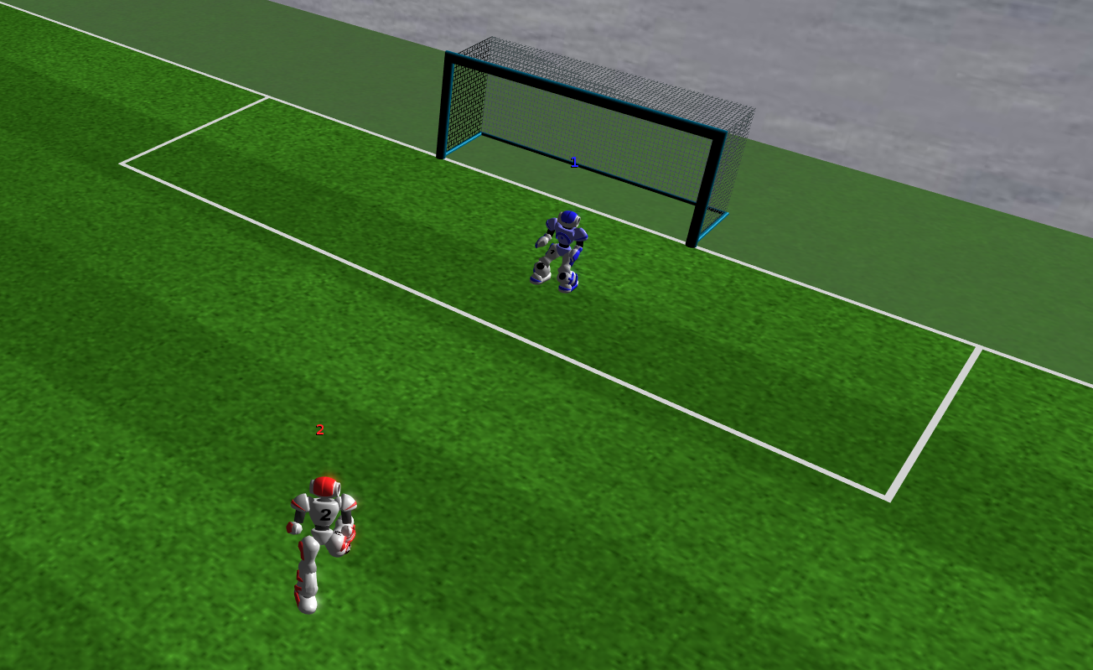
Defender State: Ball Tracking
Init
Ball Tracking
Diving Defense
Default State: Agent moves sideways to place itself between the ball and the goal
Get Up

Slide 8
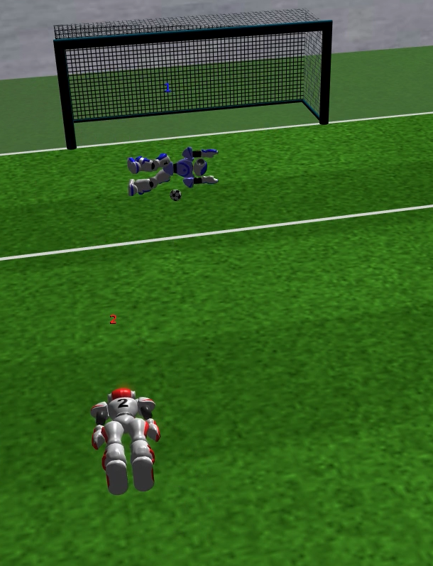
Defender State: Diving Defense
Init
Ball Tracking
Diving Defense
Get Up
Agent dives sideways to defend based on the ball’s speed and direction

Slide 9
Defender Transitions
Conditions for a transition to occur for the two main states:
If the ball is coming near (3m) with high speed (3m/s) and not straight at the goalie, it dives to the direction the ball is taking
After a dive, the agent waits a while before getting up to make sure it catches the ball.
Init
Ball Tracking
1
Diving Defense
2
Get Up

Slide 10
Attacker Agent
Optimization Algorithm: OpenAI Gym with Proximal policy optimization (PPO)
Observation Space: to reduce training time, only 8 values are known to agent:
The values are all float32, from -infinity to +infinity.
Step Counter (Nº steps) | Last Action (0-kick; 1-walk) | Player Pos. (X, Y) | Ball Pos. (X, Y) | Player-Goal Vector (Width, Depth)

Slide 11
Attacker Agent: Action Space
For the action space 6 values define the possible agent behaviors:
Behavior (0-kick; 1-walk) | Kick Direction (0-kick; 1-walk) | Walk Distance | Walk Orientation | Target Walk (X, Y)
[0, 1] | [-30, 30] | [0, 0.5] | [-π, π] | [-3, 3]
Walk Related
Binary decision thresholded at 0.5
Cone shaped kick area

Slide 12
Attacker Agent: Reward Function
Some rewards are given to incentivize the action of kicking the ball as fast as possible:
Default of -1 points to incentivize action
Each simulation step not kicking ball is -5 points
Staying close to ball yields +0.5 points per step
Further penalize proportionally on ball-player distance if the agent moves away from ball without kicking
If the agent falls without kicking the ball it receives a heavy punishment of -2000 points and the episode finishes early

Slide 13
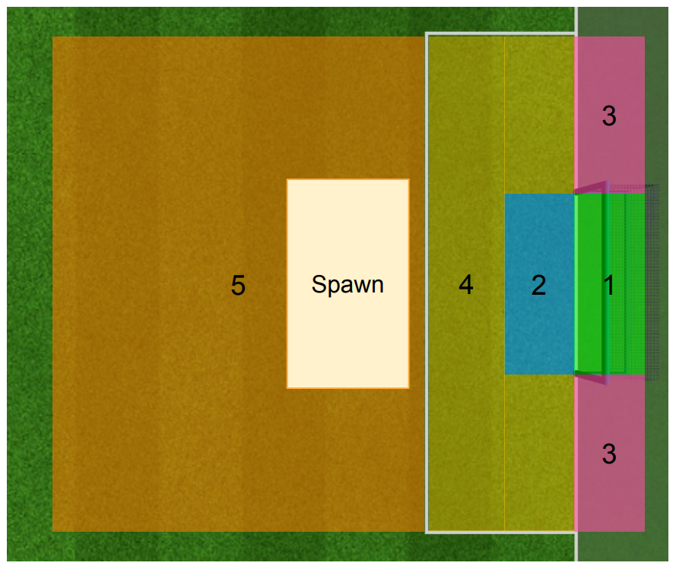
Attacker Agent: Reward Function
The terminal episodes are defined from the highlighted areas as follows, from highest positive to most negative:
1: Goal | 2500 + bonus the closer the ball is to the center
2: Almost Goal | 500 * scaler based on distance to goal (max 1000)
3: Out of Bounds | -150 * horizontal to goal offset
4 / 5: Time Limit | Heavy punishments of -1500 * ball distance to goal

Slide 14
Results Evaluation
The team separately studied and evaluated three scenarios:
Attacker without goalie
Attacker with goalie (no RL adaptation to goalie)
Attacker with goalie (with attacker RL adaptation)
The results were collected over many iterations to achieve more stable metrics. Due to relatively long RL training (each setup took ~4 hours to train), the exploration was limited

Slide 15
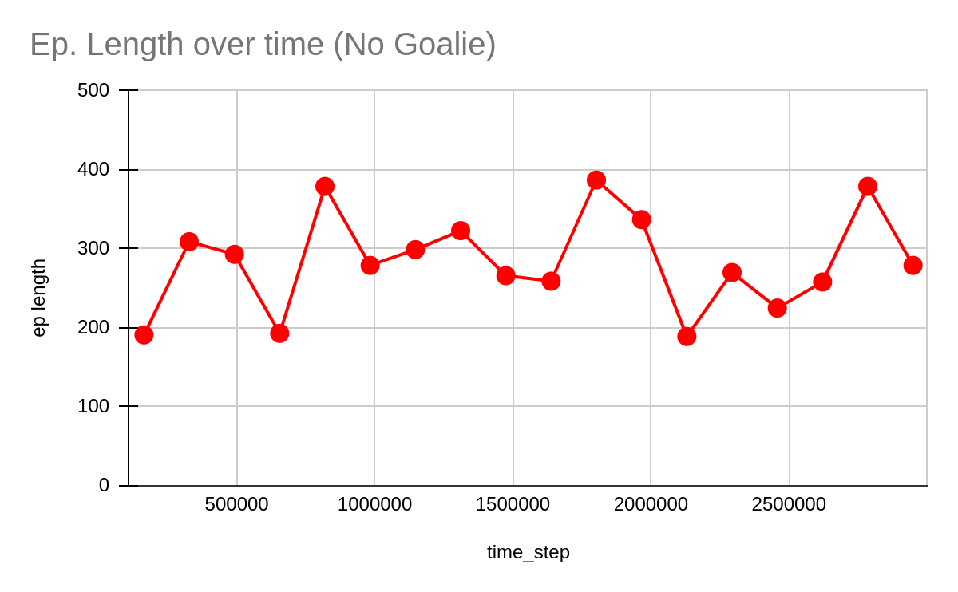
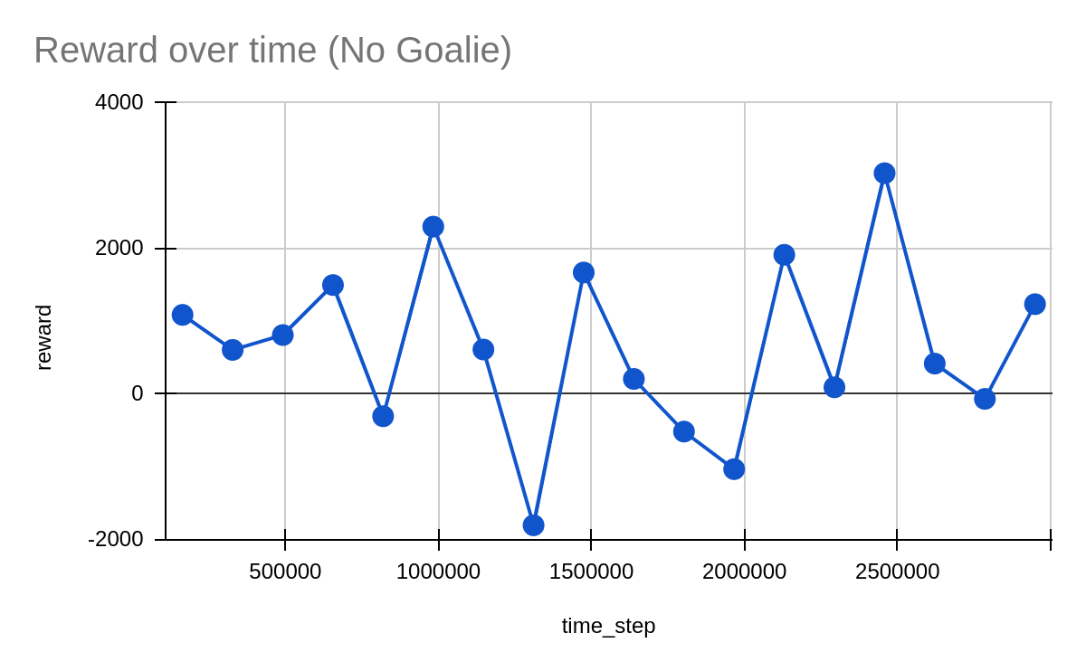
Attacker without Goalie Training
Total steps | 3,000,000
Nº iterations | 245
Train time | ~ 4h

Slide 16
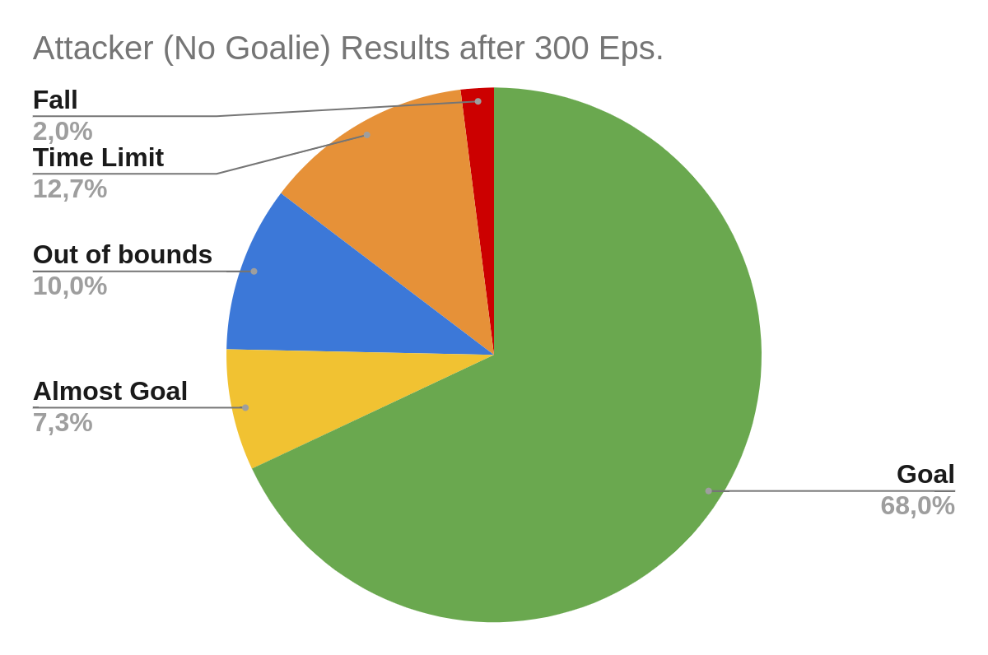
Attacker without Goalie Results
The attacker scores or almost scores 75% of the time
Less than 15% of the episodes were very punishing (fall or time limit)
In 17% of the cases, the robot has the “right intention” but either the kick force or direction was not the appropriate one

Slide 17
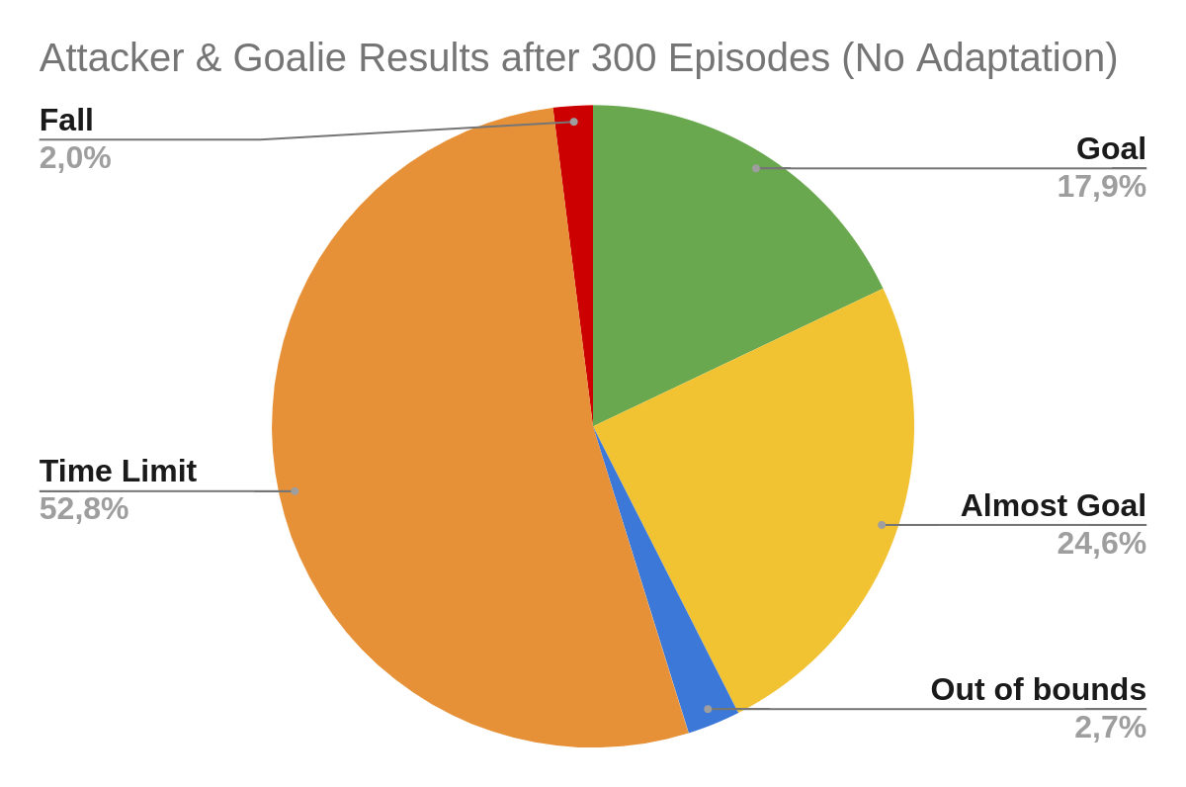
Attacker with Goalie (No Adaptation)
We also experimented putting the attacker facing the goalie without further adaptation to its presence
At first, the goalie was too efficient because the shots were mostly perpendicular to the goal and so virtually no goals were scored
As such, we removed the goalie’s option to not dive to defend a kick and got the results on the right
Note: The default codebase attacker has a success rate of ~70% against the same goalie

Slide 18
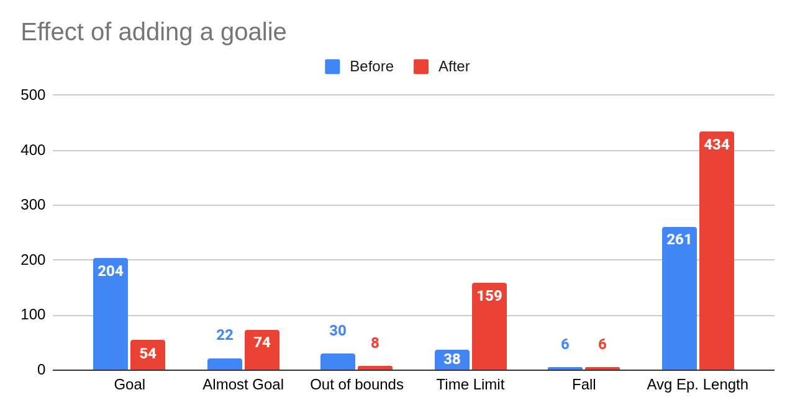
The effect of adding a goalie
The impact of adding a goalie to which the attacker wasn’t prepared is very noticeable as the goal rate dropped by 75%, being replaced by near misses.
Because we didn’t stop the episode after a defense to avoid false positives, naturally there was a big increase in episodes ended due to time limit.

Slide 19
Training the Attacker with Goalie
The following changes were made to train the attacker with the goalie’s effect in consideration:
Observation Space
Added the (X, Y) of the goalie to the observation space, making it 10 values in total
Rewards
Aggravated some penalties for not kicking the ball to further reduce wandering around
Alleviated “the out of bounds” punishment
Attenuated “end due to time” punishment if the ball was within the the 2 poles in width
Added a big goal bonus reward the further the ball was from the goalie when crossing

Slide 20
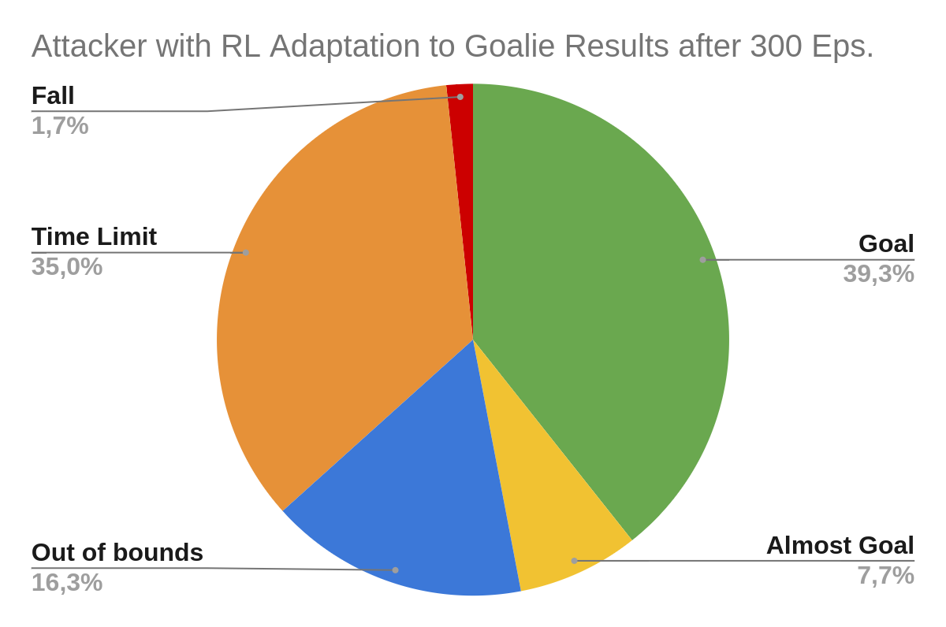
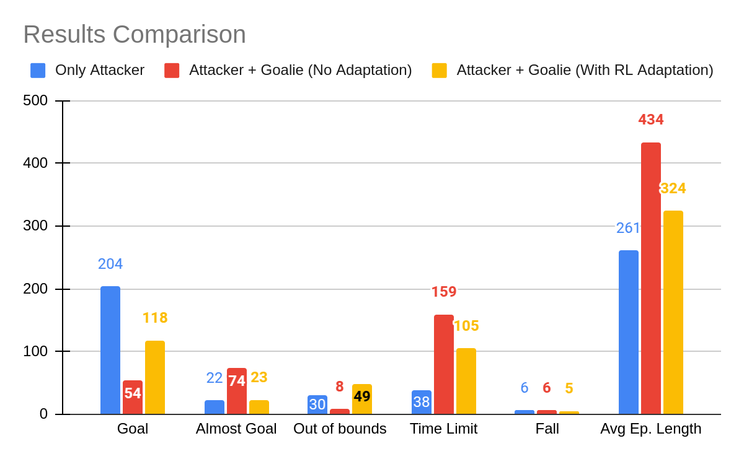
Training the Attacker with Goalie
The results show that the robot managed to adapt relatively well to the goalie, recuperating a significant part of its performance back from when it had no defender. However, this was mostly achieved by exploiting the NAO’s physical model design.

Slide 21
Development Limitations
During the development of project the following constraints were felt:
Lack of powerful computational resources for training
Limited time for testing each desired training setup
Lost time trying to work with complex codebase
Finicky adjustment of observation and action spaces and rewards for the agent
The starting training state yielded dramatically different results

Slide 22
Conclusions and Future Work
Despite this being our first experience with a RL project and facing a big codebase, we deem the achieved results positive.
The final RL agent was capable of 40% goals against a moderately capable goalie, showing the viability of RL for many real-world tasks if trained properly.
Ideally we would like to have more time to experiment different setups and have the agent trained for longer periods to stabilize the results.
Future work could also include experimenting with different algorithms besides PPO and adopt more sophisticated RL strategies.

Slide 23
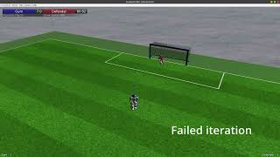
Demo Video Link:
https://youtu.be/fjvVxMVGUtA

